Slide 1
PR- 28
Signal Processing Primitives With Quantum Algorithm
G-RIS
(G=Gal Winer(Team Lead), R=Risav, I= Ibrahim )

Slide 2
Previously: Implementation that is Left for completion of mean Filter
Quantum Non Modular Division (solved by classical Approach)
While using Adder the output i.e. Sum is always stored to the new qubits that causes increase in the requirements of qubits
Measuring the only the filtered Register where quantum Information of the image is stored
Decoding Quantum State to back to the Image

Slide 3
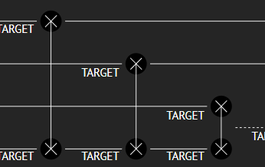
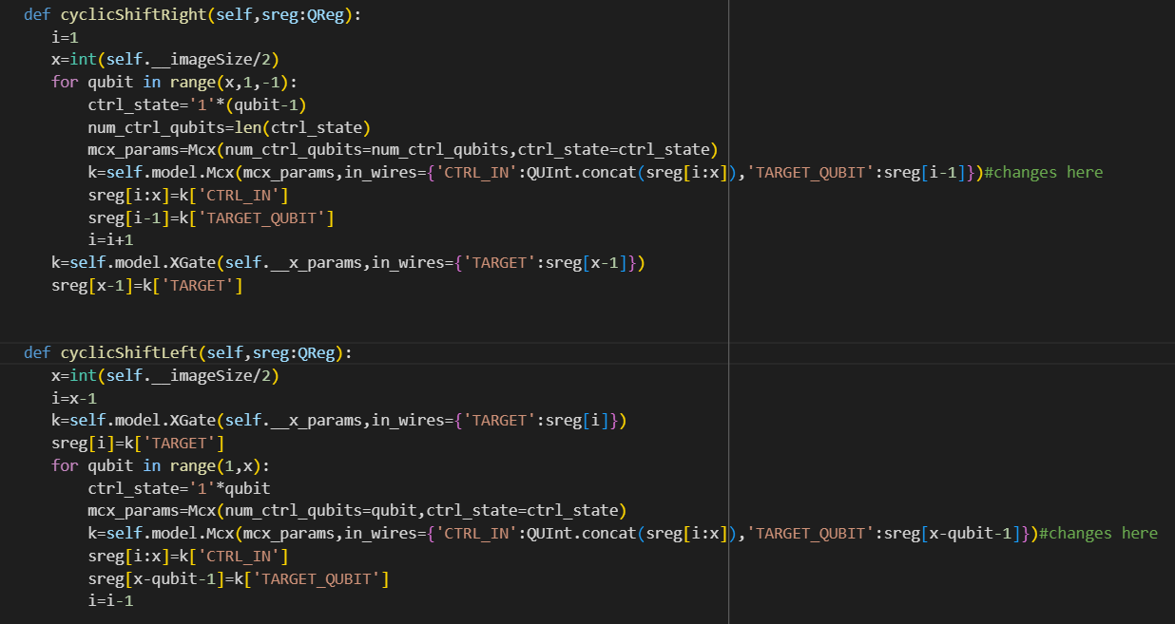
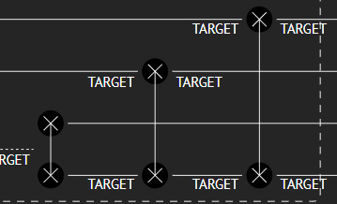
Previously I have made Mistake on Implementation of CyclicShiftYUp, CyclicShiftYDown
Also, There was some minor programming error causing shifting of both X and Y simultaneously which was not needed which is also fixed…#code

Slide 4
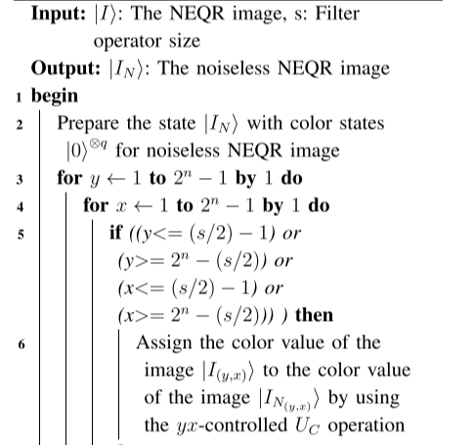
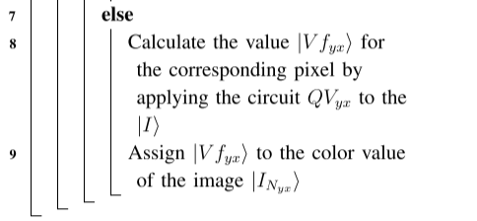
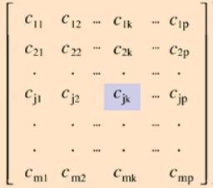
Algorithm for QMF(Quantum Mean Filter)

Slide 5
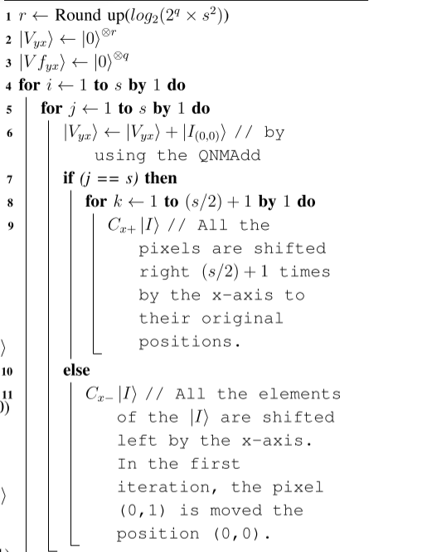
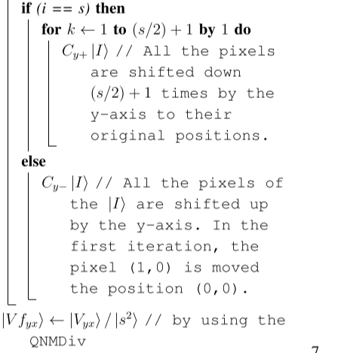
Algorithm of the operation QVxy

Slide 6
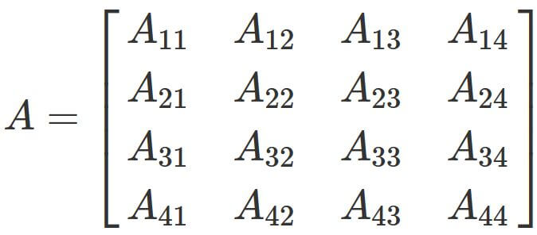
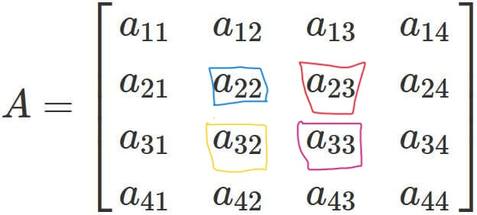
Quantum Non Modular Division Part
Analyzing the Algorithm I have found that

Slide 7
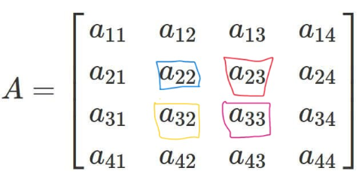

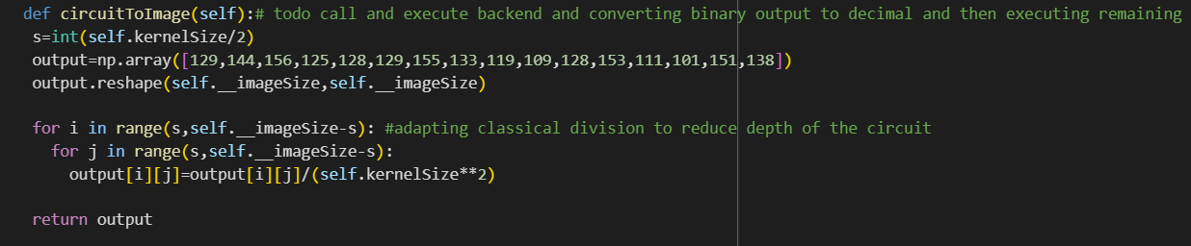
Modification to the algorithm Using classical approach
Using this approach we decrease depth and also the 16 qubit counts (roughly depending on kernel size) as we reduces 2-3 helper QReg
Also, Time Complexity for this division become O(imageSize-KernelSize)

Slide 8
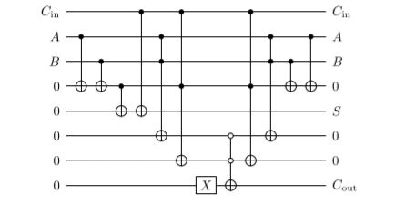
Quantum Ripple Adder

Slide 9

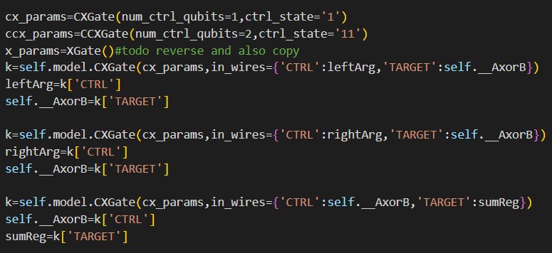
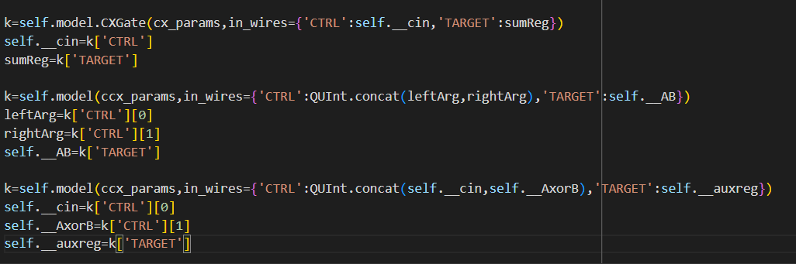
Adder problem and possible Solving method
For Adder I have encoded my own Adder function But this increases the depth of the circuit and unnecessary entanglement which can be solved by increasing Qubits. To solve it likewise we have reset in Qiskit then the Depth can also be decreased..#coding

Slide 10
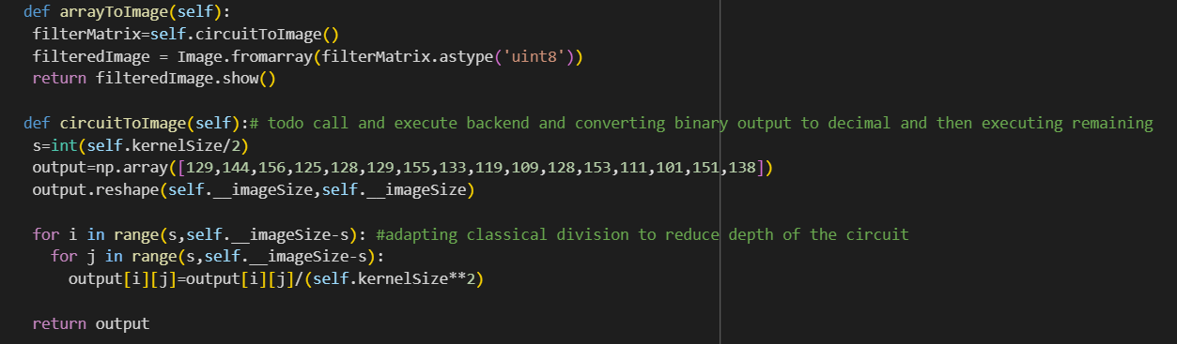
Code snippet that convert circuit to array and array to image

Slide 11
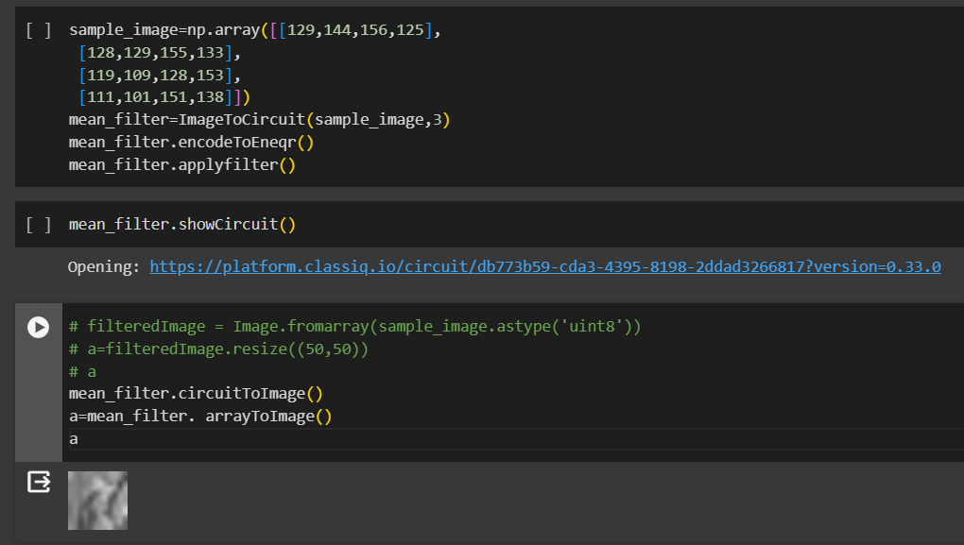
Decoding Quantum State to back to the Image

Slide 12
Thank You For Listening

